Slide 1

Financial Pathways to Independence
Appalachian Assistive Technology Loan Fund
2025

Slide 2


Appalachian Assistive Technology Loan Fund
Non-profit organization with a mission of providing cash loans to Kentuckians with disabilities and their families for the purchase of assistive technology
Subsidiary of Pennsylvania Assistive Technology Foundation
Majority of the Board and staff are individuals with disabilities and/or immediate family members
AATLF is a federally certified Community Development Financial Institution (CDFI), U.S. Treasury

Slide 3

AATLF Helps Kentuckians of All:
Income levels
Disabilities
Health Conditions
Ages
Communities
Cultural Backgrounds

Slide 4
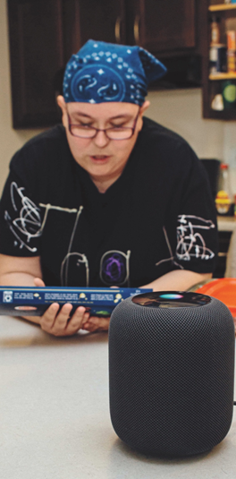
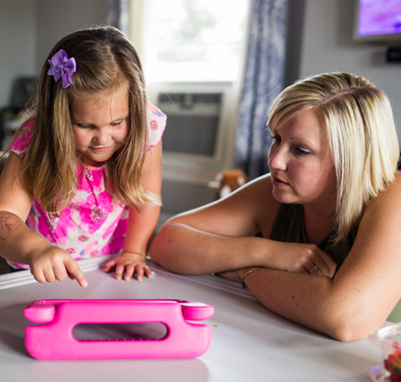
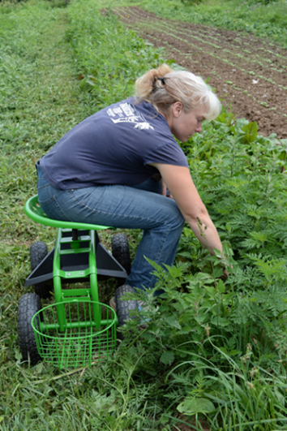
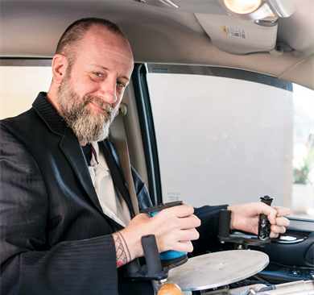
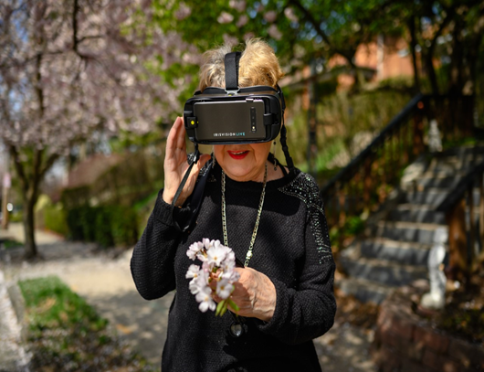
Examples of assistive technology, slide 1 of 2
What is Assistive Technology (AT)?
Any device or service that can help a
person with a disability or older adult
do the things they want to do.

Slide 5
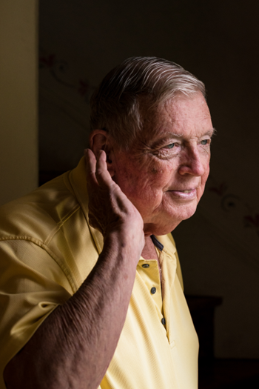
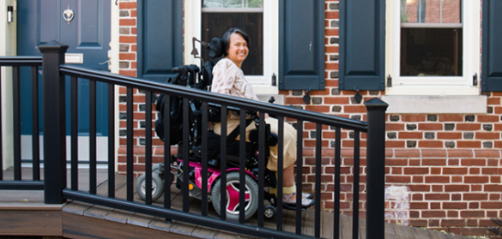
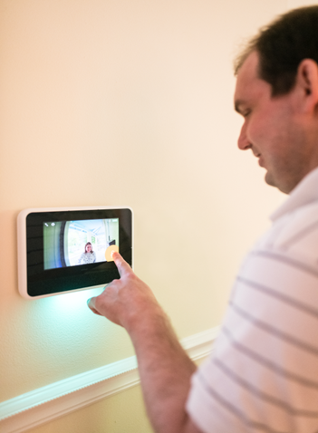
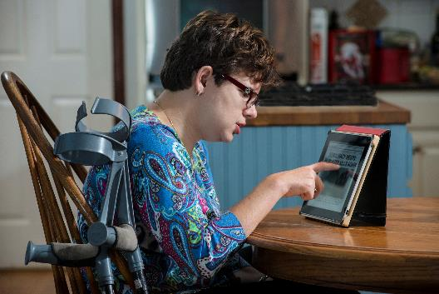
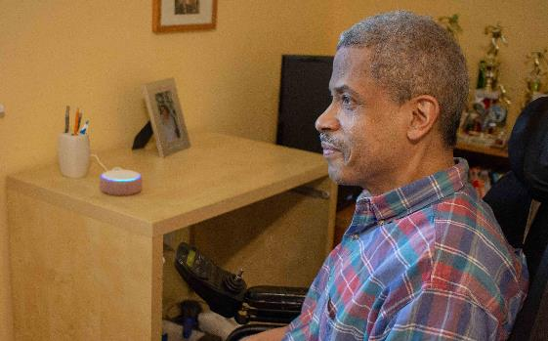
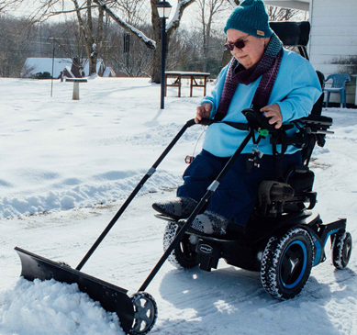
Examples of assistive technology, slide 2 of 2

Slide 6
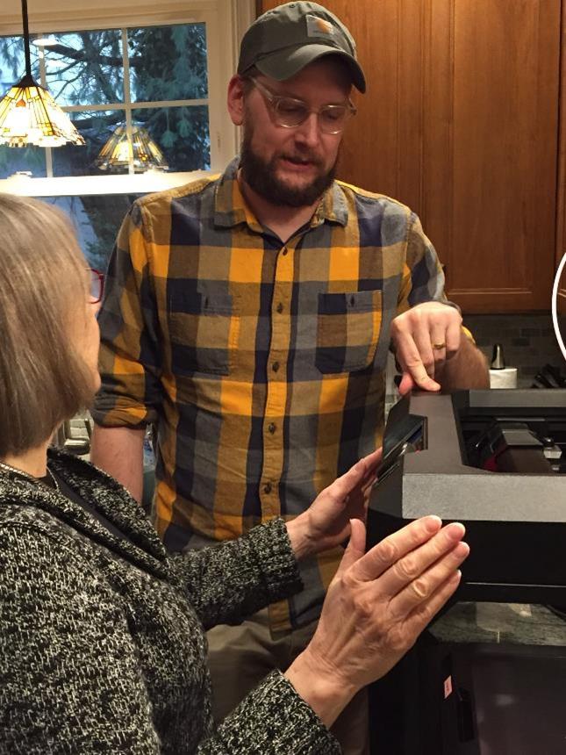
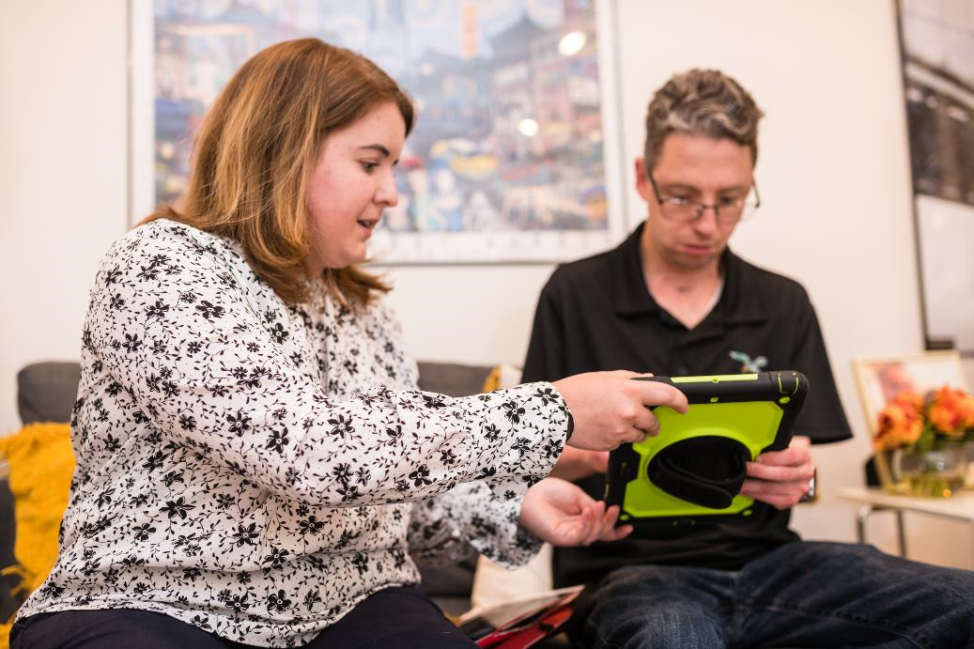
AT Services
Evaluation
Selection
Design
Installation
Setup
Training
Repair

Slide 7
AATLF Mini-Loan Program
$100 to $7,000
0% interest, no fees
Repayment Terms up to 48 months
Opportunity to Build Positive Credit: All repayments are reported to Experian, TransUnion, and Equifax.

Slide 8
AATLF Mini-Loan Example – John
John was diagnosed with ALS and recently became a wheelchair user. He contacted AATLF for a loan to purchase a smart speaker with a display and a smart thermostat, which would allow him to control his environment through his tablet. An AATLF Mini-Loan covered the cost of the new smart home devices, along with the installation and training expenses.
AT | Cost | Mini-Loan | Loan Payment
Echo Show, Nest Thermostat, Device Installation and Training | $530 | 0% interest no fees 20-month repayment term | $26.50/month

Slide 9
AATLF Mini-Loan Example – Patricia
Patricia has been blind for 63 years and requested a loan for an Iris Vision Magnifier. “The main thing I want to do with my new glasses is see all the things I haven’t seen since I was very young. Just little things like looking at a butterfly and being able to weed in my garden, to see nature, and all the things you take for granted. I don’t want to sound dramatic, but that’s really special to me. It’s nice to look over and see my dog sleeping.”
AT | Cost | Mini-Loan | Loan Payment
Iris Vision Magnifier | $3,300 | 0% interest, no fees loan With repayment term of 36 months | $91.67/month
Notes:
.

Slide 10
How to Apply for an AATLF Loan
Complete an electronic loan application by going to AATLF.org.
Paper applications are also available and can be mailed to AATLF’s office.
Completed applications and supporting documents can be mailed, faxed @ 484-674-0510, or submitted via a DocuDrop link.
If you would have any questions or need assistance, please call AATLF at 484-674-0506.

Slide 11

Contact Information
Website: aatlf.org
Email: lending@patf.us
Telephone: 484-674-0506

